Slide 1
HTML TABLES
Athoug Alsoughayer

Slide 2
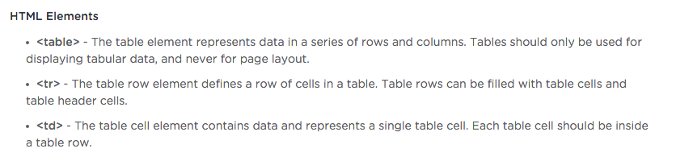
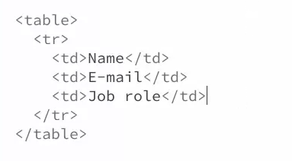
Create a Basic Table
Similar to an HTML form, you start out creating an HTML table by using the <table> element. It has an opening and closing tag, and it wraps all the table rows and table cells inside of it.

Slide 3

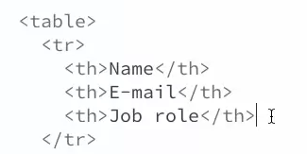
The table header cell element helps to differentiate between header cells and regular table data. This is helpful for search engine crawlers and screen readers, as well as for CSS styling.

Slide 4
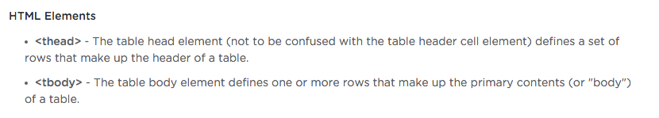
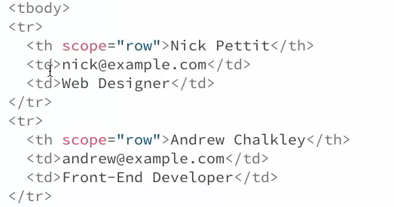
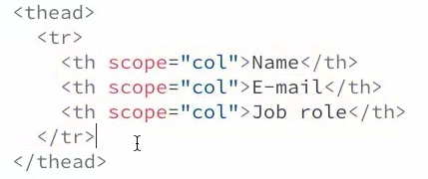
The Table Head and Body Elements
The table head element is a completely different element from the table header cell element. In combination with the table body element, the table will gain additional structure.

Slide 5
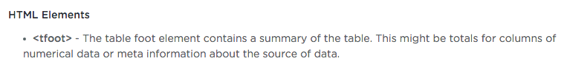
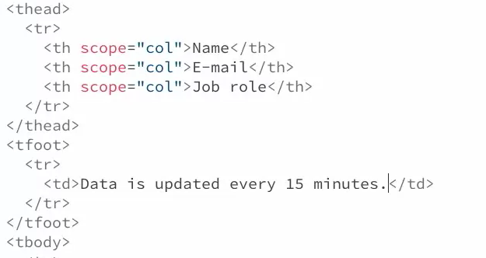
The Table Foot Element
In general a table footer element should contain a summary of the table. This might be some final cells that are sums, totals, and averages for each column. A table footer might also just contain some meta information about the table itself, such as how frequently the table is updated, copyright information, or perhaps the source of the data within the table.

Slide 6
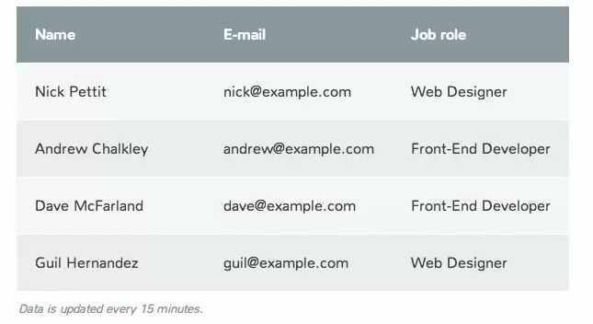

Slide 7
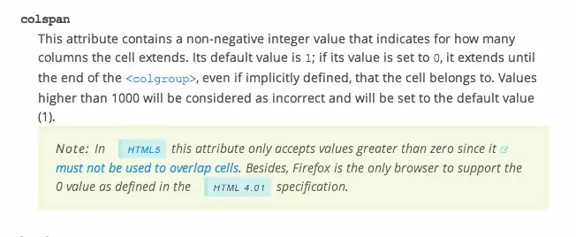
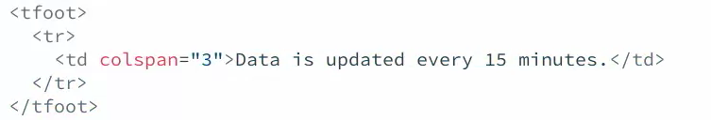

Slide 8
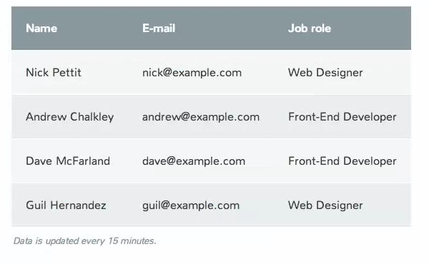

Slide 9
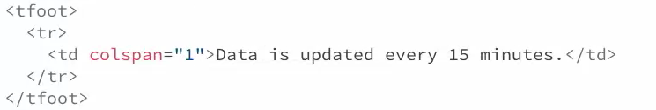
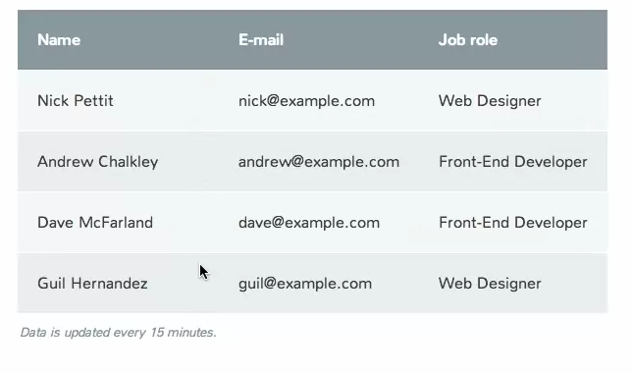

Slide 10
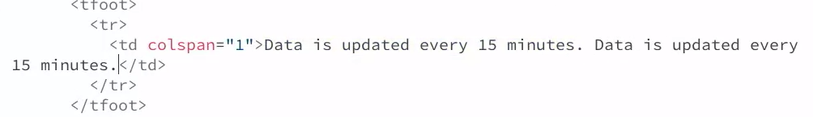
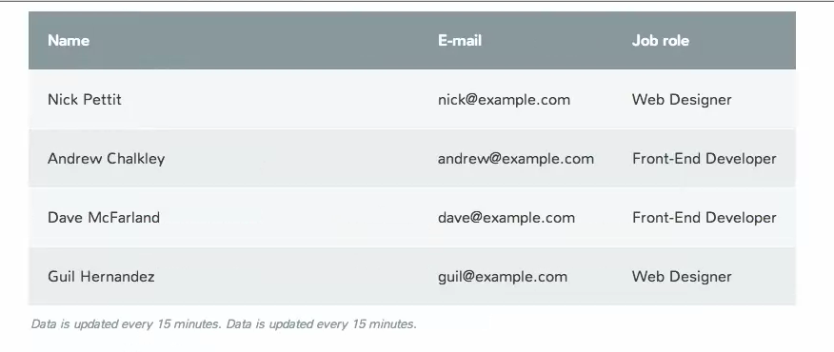

Slide 11


The Caption Element
The caption element is basically a title for the table, and it should come immediately after the opening table tag. This is nice to add because it quickly summarizes what a table might contain.

Slide 12
